Slide 1

Telemetry Data Web Application
Team: 23-3110-AC
Charlie James, Tej Chapaneri & Victoria Hektor

Slide 2
AGENDA
Meet the Team
Introduction
Backend Overview
Frontend Overview
The Fluffy Stuff
Primary Goals & Demonstration
Roles, Contributions & How we got there
Summary, questions & Thank you

Slide 3



MEET OUR TEAM
Charlie James
Victoria Hektor
Tej Chapaneri

Slide 4
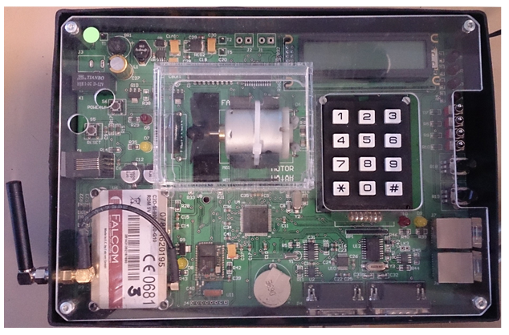
INTRODUCTION
What telemetry our embedded system has:
Four Switches – on/off states
Fan – Forward/Reverse states
Heater – Temperature State
Keypad – Last number entered (Integer state)
Welcome to our presentation for the Secure Web App Development module coursework – Telemetry Data Processing.
We have taken into consideration the coursework brief and worked together as a team to produce a telemetry data processing web application.
Considerations:
Objective – download, validate, store and display telemetry data
Development Framework – SLIM Framework, Twig template engine
Separation of Concerns architecture & Single Point of Access
Object Oriented PHP
Monolog Logging
Unit testing, Docblock comments, MySQL/MariaDB, SOAP Client
PSR1 & PSR 12 Coding guidelines
GitHub & SVN

Slide 5



Back end – Overview
Here we utilised the work provided in the labs to guide us on where to start, we visualised the architecture and each took a section. Over the development stages, a refactoring took place by Tej, as the understanding of the components deepened, this ensured correctness and deliverables in-line with the brief. We have successfully utilised the following tools for the backend development:
Database – PDO, MySQL, MariaDB
PHP, SLIM, SOC & SPA
Monolog Logging
SOAP
MVC Architecture
Dependencies

Slide 6



Front End - Overview
For the frontend we utilised the demonstration learning via the labs to start us moving forward on this, Twig allowed us set out the design with an easy-to-use architecture and allowing for fast, secure and flexible frontend development. Further learning and discovery allowed for additional features to be added including a dashboard and numeric telemetry data graphs.
Twig Templating Engine
HTML
Javascript/Bootstrap

Slide 7




The Fluffy stuff
When we say ‘fluffy stuff’ we mean; the testing, Docblock comments, coding support for the lead when additional functions are needed within existing code, HTML validation, SVN & GitHub Commits, planning and presentation.
Considerations:
HTML Validation using W3 Validator
Utilised PHPUnit & Attempted PHPCodeSniffer Tests
Regular commits to GitHub & SVN
Written plans & Presentations
Docblock Comments

Slide 8
PRIMARY GOALS
In this section we will demonstrate each goal via a backend and frontend demonstration:
Login/Logout/Register Functionality
Displaying numerical data in chart form
Admin Dashboard/interface which manages users and data in DB
Email functionality/notification
Checking & Sending message data
Monolog Logging
Validation & Checking of message data & Parse downloaded messages
Unit Testing & Security Testing
Slim Framework
SOAP & WSDL File
Docblock Comments
Twig Template Engine
2023
SWAD Coursework

Slide 9
Roles
Tej
Naturally took the lead
Charlie
A Wizz at being the Interface/Front-End guy
Victoria
Better at taking on the fluffy stuff; support & admin roles, testing, & planning. etc
Web Application Developer
Database Administrator
Throughout the project we constantly revised our plan and strategy, it was clear in the beginning that Tej could lead us well, and offers a more developed technical knowledge base so it made sense for him to lead on this project and the development, Tej also persevered with any issues/bugs we had with the teams support and suggestions. Charlie, as well as having technical expertise, has a naturally curious nature and sought out ways we could implement some of the functionalities that we hadn’t learnt in the classroom, eg. Depicting data in chart form. Victoria helped out when Tej and Charlie asked for support with the development, carried out html validating, testing and docblock comments, required support from Charlie & Tej for the more technical side of the development who were only to happy to help.

Slide 10
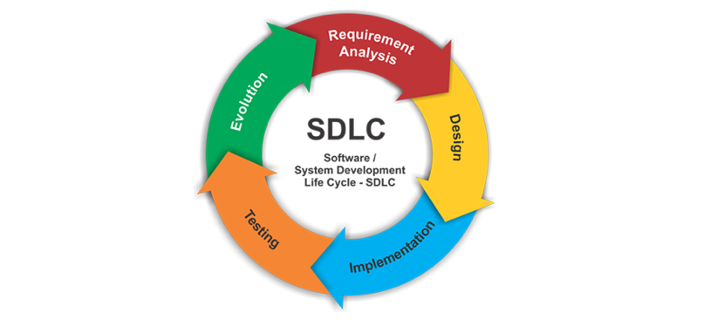
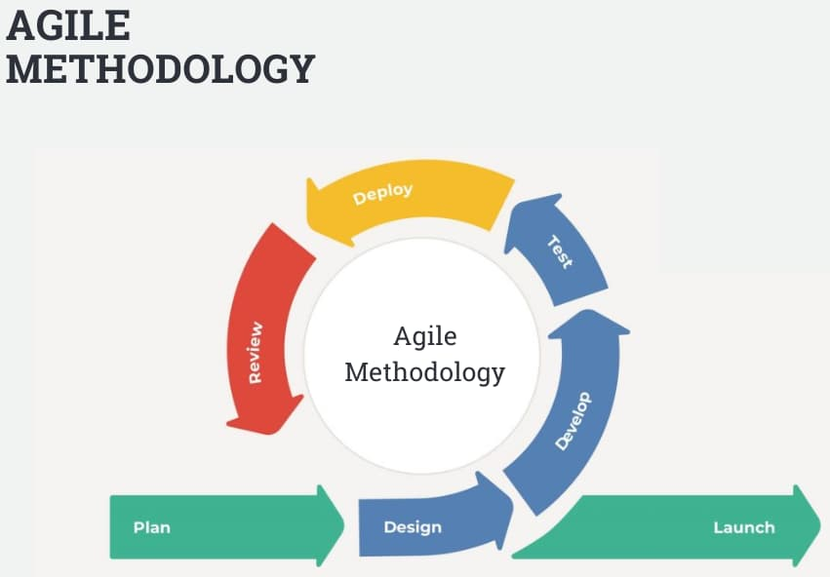
The Process
Software Development Life Cycle
For this groupwork we followed SDLC, to allow for a structured way to plan, design and implement the project to the brief. Throughout the project numerous meetings were held whereby the project was discussed and a revised plan put in place each time to tackle anything that needed completing. We planned at various stages and at each point of creation it was tested in the localhost environment to check the functionality and output.
Agile Methodology
Teamwork & Support
We actively followed the agile methodology to ensure we had flexibility to adapt to changes that may arise throughout the course of development, including refactoring. This also allowed for a more collaborative approach to development and regular meetings to support the whole team.
Throughout the whole project support was never withheld and learning opportunities were never missed. This project has given us the opportunity to engage in a mock project working collaboratively as a team and provided invaluable experience and learning curves.

Slide 11

SUMMARY
In summary:
We have successfully worked as team towards a common goal and project
Completed the objectives of; download, validate, store and display telemetry data
Used SOC & SPA, along with Docblock comments for ease of understanding and adaptable for collaboration
Carried out testing via PHPUnit, frontend forms, and PHPCodeSniffer
Utilised the Slim Framework and Twig templating engine to ensure the best security, readability and adaptability for our system
Attempted most/all tasks set out in the brief, learnt what worked and what didn’t
Created a supportive and collaborative working space for the whole team utilising SDLC & Agile Methodology

Slide 12
THANK YOU & Any Questions
Tej Chapaneri
Charlie James
Victoria Hektor

